Slide 1
I/O Buses and Interfaces
HNDIT24012 Computer Architecture

Slide 2
I/O Hardware
Putting I/O devices into ‘boxes’ we typically have
Storage devices (disks, tapes, etc.)
Transmission devices (network cards, modems)
Human-interface devices (screens, keyboards, mice, joysticks…)
Devices all communicate over cables (or air) with the machine using ‘standard’ connections:
Ports,
Buses (daisy chained or shared host adaptor), and
Device Controllers.

Slide 3
1. Ports
The CPU and its supporting circuitry provide Memory-mapped I/O, which involves a range of memory addresses simply set aside and are mapped to device registers.
Reads and writes to these memory addresses cause the data to be transferred to and from the device registers.
A computer using memory-mapped I/O accesses hardware by reading and writing to specific memory locations using the same assembler language instructions that the computer would normally use to access memory.
So to accommodate the I/O devices, areas of CPU’s addressable space must be reserved for I/O (even temporarily) rather than memory.
Notes:
Hardware that has (most do) two port addresses – some more. These addresses are usually bound closely in sequence.
First port is usually the index port – usually has write only access ore read/write access. Second port is the actual data access. Usually has r/w access.
You will need to program the index register first to specify which data you want to access before you can access data inside the hardware itself.

Slide 4
Ports
But the thinking of memory-mapped I/O can be applied to other devices such as the serial and parallel ports used to connect modems and printers to a computer.
Here, the CPU transfers data through these devices by reading and writing a few device registers called an I/O port.
Port-mapped I/O usually requires the use of special instructions which are specifically designed to perform I/O operations, such as the IN and OUT instructions found on Intel microprocessors.
Here, I/O devices have a separate address space from general memory – either accomplished by an extra I/O pin on the CPU’s physical interface or an entire bus dedicated to I/O
Notes:
Hardware that has (most do) two port addresses – some more. These addresses are usually bound closely in sequence.
First port is usually the index port – usually has write only access ore read/write access. Second port is the actual data access. Usually has r/w access.
You will need to program the index register first to specify which data you want to access before you can access data inside the hardware itself.

Slide 5
Ports
I/O ports only accept numbers (byte – 8 bits; or word (16 or 32 bits)
This input depends on the hardware you want to deal with.
More interest: A computer using memory-mapped I/O accesses hardware by reading and writing to specific memory locations – using the same assembler language instructions that the computer would normally use to access memory.
(Access: not every port has both read and write access. Some have read only; some only write access.
Interestingly, there may be a port register, which you may view as an array of data inside the hardware)
Notes:
Hardware that has (most do) two port addresses – some more. These addresses are usually bound closely in sequence.
First port is usually the index port – usually has write only access ore read/write access. Second port is the actual data access. Usually has r/w access.
You will need to program the index register first to specify which data you want to access before you can access data inside the hardware itself.

Slide 6
Ports
I/O ports are simply a few registers supporting data transfer from I/O devices and main memory.
Very specific I/O instructions are executed to allow this data transfer to take place between these registers and main memory.
So, simply consider a port as a set of hardware addresses whose contents are accessed via specific low-level instructions (ahead).
If we access hardware through ports, we are dealing with the hardware directly. Mistakes may be disastrous, however, because there is no validation whether your input is correct or not – in general.
Notes:
Hardware that has (most do) two port addresses – some more. These addresses are usually bound closely in sequence.
First port is usually the index port – usually has write only access ore read/write access. Second port is the actual data access. Usually has r/w access.
You will need to program the index register first to specify which data you want to access before you can access data inside the hardware itself.

Slide 7
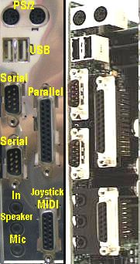
Port Picture – older device
This picture shows an internal view of some of the I/O ports on the right and a covered view on the left.
On the back of computers are several I/O ports.
Above, on the very top are two PS/2 ports, normally used for mouse and keyboard connections.
Below those are two USB, (or Universal Serial Bus), ports.
Below those are two serial ports beside a long parallel port that is often used to connect to a printer.
On the bottom right is a game port for joysticks or other game controllers.
On the bottom left is a microphone hook up, a speaker hook up, and an additional hook up for another sound input device like a musical keyboard.

Slide 8
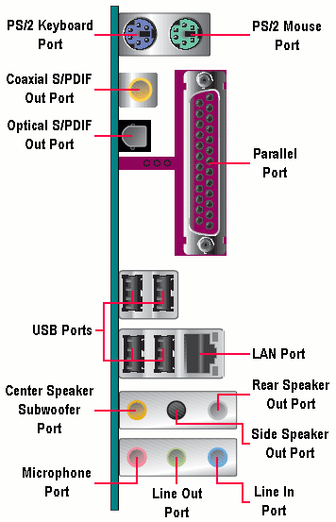
More Modern Port View
These are typical ports on a more modern computer:

Slide 9
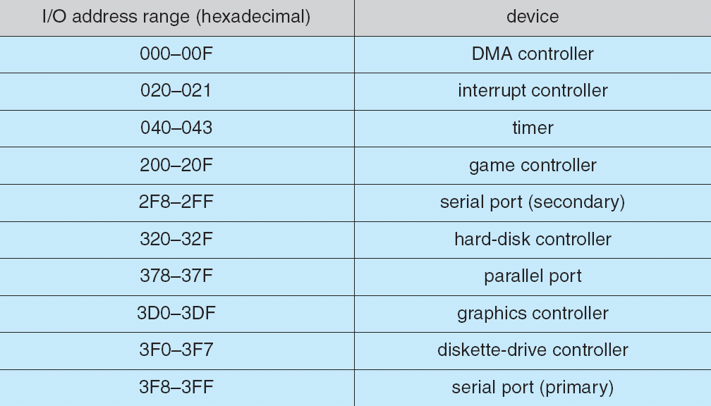
Device I/O Port Locations on PCs (partial)
Here, you can see some of the addresses set aside to support I/O

Slide 10
2. Buses
In computer architecture, a bus is a subsystem that transfers data between computer components inside a computer or between computers.
Unlike a point-to-point connection, a bus can logically connect several peripherals over the same set of wires.
Each bus defines its set of connectors to physically plug devices, cards or cables together.

Slide 11
Buses
Modern computer buses can use both parallel and bit-serial connections, and can be wired in either a multi-drop (electrical parallel) or daisy chain topology, or connected by switched hubs, as in the case of USB.
Simply stated, however, a bus is just a set of wires with carefully defined protocols that specify a set of messages that can be sent on the wires.
Different patterns of electrical voltages are applied to the wires with defined timings.

Slide 12
Buses: Parallel and Serial; Internal and External; Blurring with new technologies…
Parallel buses carry data words in parallel on multiple wires; Serial buses carry data in bit-serial form.
As data rates increase, the problems of timing skew, power consumption, electromagnetic interference and crosstalk across parallel buses become more and more difficult to avoid
Often, a serial bus can actually be operated at higher overall data rates than a parallel bus, despite having fewer electrical connections, because a serial bus inherently has no timing skew or crosstalk.
Most computers have both internal and external buses.
Internal bus connects all the internal components of a computer to the motherboard (and thus, the CPU and internal memory). Also called local bus, because they are intended to connect to local devices, not to those in other machines or external to the computer.
External bus connects external peripherals to the motherboard.
Network connections such as Ethernet are not generally regarded as buses, although the difference is largely conceptual rather than practical.
Notes:
Examples of serial buses: USB, FireWire, and Serial ATA are examples of this. Multidrop connections do not work well for fast serial buses, so most modern serial buses use daisy-chain or hub designs.

Slide 13
Typical modern PC buses
PCI
PCI Express
AGP
ISA
SATA
USB 1.1/ 2.0/ 3.0
Firewire
RAM Interface DDR/ DDR2/ DDR3
Etc.

Slide 14
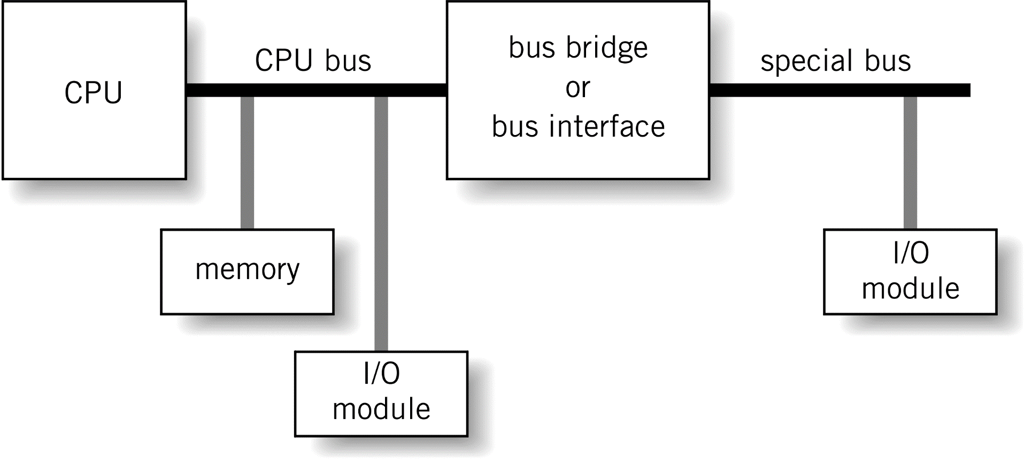
Bus Configuration

Slide 15
Bus Characteristics
Data width in bits carried simultaneously
Throughput, i.e., data transfer rate in bits per second
Point-to-Point vs. Multipoint
Parallel vs. Serial
Use
Distance
Protocol

Slide 16
Bus Hierarchy
Processor bus: on-chip
Cache bus (backside bus)
Memory bus (front-side bus)
connects the memory subsystem and processor
Local I/O bus
high-speed bus used to connect performance critical peripherals to memory and processor
Examples: PCI, VESA Local Bus
Standard I/O bus
connects slower peripherals (ISA) to Local I/O bus

Slide 17
CPU-Memory-I/O Architecture
Memory
CPU
I/O module
I/O device
“CPU bus”
or
“System bus”
“Bus interface”
“I/O bus”

Slide 18
I/O Buses and Interfaces
There are many “standards” for I/O buses and interfaces
Standards allow “open architectures”
Many vendors can provide peripheral (I/O) devices for many different systems
Most systems support several I/O buses and I/O interfaces

Slide 19
Examples
Expansion buses or “slots”
Disk interfaces
External buses
Communications interfaces

Slide 20
Expansion Buses
These are “slots” on the motherboard
Examples
ISA – Industry Standard Architecture
PCI – Personal Component Interconnect
EISA – Extended ISA
SIMM – Single Inline Memory Module
DIMM – Dual Inline Memory Module
MCA – Micro-Channel Architecture
AGP – Accelerated Graphics Port
VESA – Video Electronics Standards Association
PCMCIA – Personal Computer Memory Card International Association (not just memory!)

Slide 21
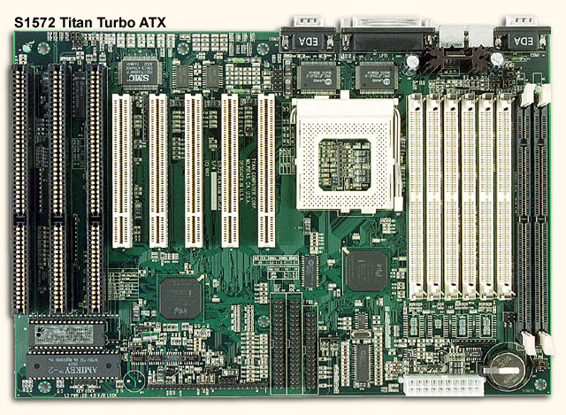
3 ISA slots
5 PCI slots
Pentium CPU
6 SIMM slots
2 DIMM slots

Slide 22
Examples
Expansion buses or “slots”
Disk interfaces
External buses
Communications buses

Slide 23
Disk Interfaces
Examples
ATA – AT Attachment (named after IBM PC-AT)
IDE – Integrated Drive Electronics (same as ATA)
Enhanced IDE
Encompasses several older standards (ST-506/ST-412, IDE, ESDI, ATA-2, ATA-3, ATA-4)
Floppy disk
SCSI – Small Computer Systems Interface
ESDI – Enhanced Small Device Interface (mid-80s, obsolete)
PCMCIA

Slide 24
Examples
Expansion buses or “slots”
Disk interfaces
External buses
Communications buses

Slide 25
External Buses
Examples
Parallel – sometimes called LPT (“line printer”)
Serial – typically RS232C (sometimes RS422)
PS/2 – for keyboards and mice
USB – Universal Serial Bus
IrDA – Infrared Device Attachment
FireWire(IEEE1394) – new, very high speed, developed by IEEE

Slide 26
Examples
Expansion buses or “slots”
Disk interfaces
External buses
Communications buses

Slide 27
Communications Buses
For connecting systems to systems
Parallel/LPT
special purpose, e.g., using special software (Laplink) to transfer data between systems
Serial/RS232C
To connect a system to a voice-grade modem
Ethernet
To connect a system to a high-speed network

Slide 28
Buses to Buses to Buses to…
An I/O module is an interface between the system bus and an I/O bus
An I/O module may also interface an I/O bus to an I/O bus
Let’s see…

Slide 29
Motherboard
PCMCIA bus
RS232C
bus
PCMCIA
slot
PCMCIA
serial card
I/O module
I/O module
Modem
Memory

PCMCIA
slot
PCMCIA
SCSI card
CPU
I/O module
I/O module
Disk
CPU/system bus
PCMCIA
bus
SCSI
bus
Disk

Slide 30
A Detailed Look
Let’s look at a few of the preceding examples in more detail
ISA
PCI
AGP
Serial
Parallel
SCSI
Ethernet

Slide 31
ISA (1 of 3)
Industry Standard Architecture
pronounced “eye-es-eh”
History
Originally introduced in the IBM PC (1981) as an 8 bit expansion slot
Runs at 8.3 MHz with data rate of 7.9 Mbytes/s
16-bit version introduced with the IBM PC/AT
Runs at 15.9 MHz with data rate of 15.9 Mbytes/s (?)
Sometimes just called the “AT bus”
Today, all ISA slots are 16 bit
Configuration
Parallel, multi-drop

Slide 32
ISA (2 of 3)
Used for…
Just about any peripheral (sound cards, disk drives, etc.)
PnP ISA
In 1993, Intel and Microsoft introduced “PnP ISA”, for plug-and-play ISA
Allows the operating system to configure expansion boards automatically
Form factor
Large connector in two segments
Smaller segment is the 8-bit interface (36 signals)
Larger segment is for the 16-bit expansion (62 signals)
8-bit cards only use the smaller segment

Slide 33
ISA (3 of 3)
Advancements
EISA
Extended ISA
Design by nine IBM competitors (AST, Compaq, Epson, HP, NEC, Olivetti, Tandy, WYSE, Zenith)
Intended to compete with IBM’s MCA
EISA is hardware compatible with ISA
MCA
Micro Channel Architecture
Introduced by IBM in 1987 as a replacement for the AT/ISA bus
EISA and MCA have not been successful!

Slide 34
A Detailed Look
Let’s look at a few of the preceding examples in more detail
ISA
PCI
AGP
Serial
Parallel
SCSI
Ethernet

Slide 35
PCI (1 of 2)
Peripheral Component Interconnect
Also called “Local Bus”
History
Developed by Intel (1993)
Very successful, widely used
Much faster than ISA
Gradually replacing ISA
Configuration
Parallel, multi-drop

Slide 36
PCI (2 of 2)
Used for…
Just about any peripheral
Can support multiple high-performance devices
Graphics, full-motion video, SCSI, local area networks, etc.
Specifications
64-bit bus capability
Usually implemented as a 32-bit bus
Runs at 33 MHz or 66 MHz
At 33 MHz and a 32-bit bus, data rate is 133 Mbytes/s

Slide 37
A Detailed Look
Let’s look at a few of the preceding examples in more detail
ISA
PCI
AGP
Serial
Parallel
SCSI
Ethernet

Slide 38
AGP
Accelerated Graphics Port
History
First appeared on Pentium II boards
Developed just for graphics (especially 3D graphics)
Configuration
Parallel, point-to-point (only one AGP port / system)
Specifications
Data rates up to 532 Mbytes/s (that’s 4x PCI!)

Slide 39
Identifying ISA, PCI, & AGP slots
Here’s an image to help in identifying slots
Back of computer
AGP slot
PCI slot
ISA slot

Slide 40
A Detailed Look
Let’s look at a few of the preceding examples in more detail
ISA
PCI
AGP
Serial
Parallel
SCSI
Ethernet

Slide 41
Serial Interfaces
On PCs, a “serial interface” implies a “COM port”, or “communications port”
COM1, COM2, COM3, etc.
COM ports conform to the RS-232C interface standard, so…

Slide 42
RS-232C
History
Well-established standard, developed by the EIA (Electronics Industry Association) in 1960s
Originally intended as an electrical specification to connect computer terminals to modems
Defines the interface between a DTE and a DCE
DTE = Data Terminal Equipment (terminal)
DCE = Data Communications Equipment (modem)
A “modem” is sometimes called a “data set”
A “terminal” is anything at the “terminus” of the connection
VDT (video display terminal), computer, printer, etc.

Slide 43




“Traditional” Configuration
DTE
DCE
DCE
DTE
Telephone network
RS-232C
RS-232C

Slide 44
RS-232C Specifications
Data rate
Maximum specified data rate is 20 Kbits/s with a maximum cable length of 15 meters
However…
It is common to “push” an RS-232C interface to higher data rates
Data rates to 1 Mbit/s can be achieved (with short cables!)
Configuration
Serial, point-to-point

Slide 45
Serial Data Transmission
Two modes
Asynchronous
The transmitting and receiving devices are not synchronized
A clock signal is not transmitted along with the data
Synchronous
The transmitting and receiving devices are synchronized
A clock signal is transmitted along with the data (and is used to synchronized the devices)
Most (but not all) RS-232C interfaces are asynchronous!

Slide 46
Asynchronous Data Transmission
Data are transmitted on the TD (transmit data) line in packets, typically, of 7 or 8 bits
Each packet is “framed” by a “start bit” (0) at the beginning, and a “stop bit” (1) at the end
Optionally, a “parity bit” is inserted at the end of the packet (before the stop bit)
The parity bit establishes either “even parity” or “odd parity” with the data bits in the packet
E.g., even parity: the total number of bits “equal to 1” (including the data bits and the parity bit) is an “even number

Slide 47
1’s and 0’s in RS-232C
A “1” is called a “mark”
A “0” is called a “space”
The idle state for an RS-232C line is a 1 (“mark”)
Idle state is called “marking the line”
Voltages on an RS-232C line
Well… that’s another story, and it’s not really a concern to us

Slide 48
Data Transmission Example
Plot of the asynchronous RS-232C transmission of the ASCII character ‘a’ with odd parity:
Idle
state
Start bit
Stop bit
Idle state
TD
 | 0 | 1 | 0 | 0 | 0 | 0 | 1 | 1 | 0 | 1
time
ASCII character ‘a’
7 bits
LSB first
Parity bit

Slide 49
Exercise – RS-232C
Plot the transmission of the ASCII character “X” over an asynchronous RS-232C channel with 7 data bits and even parity
Skip answer
Answer

Slide 50
Exercise – RS-232C
Answer
Plot the transmission of the ASCII character “X” over an asynchronous RS-232C channel with 7 data bits and even parity
TD
 | 0 | 0 | 0 | 0 | 1 | 1 | 0 | 1 | 1 | 1
time

Slide 51
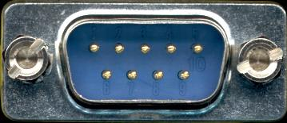
RS-232C Connectors
The original standard specified a 25-pin connector
Today, a 9-pin connector is more common
E.g.,
DB9P
Note:
P = “pin”
Sometimes called a “male” connector
The mate for this is a DP25S, or “socket” connector – the “female”

Slide 52




RS-232C Connectors
Pin 1
Pin 1
DB25P
DB25S
Pin 1
Pin 1
DB9P
DB9S
Where is pin 1?
Where are pins 2, 3, 4, etc.?

Slide 53
RS-232C Pin Numbers
1
2
3
4
5
DB9P
9
8
7
6

Slide 54
RS-232C Pins, Signals, Directions
Pin
DB25
1
2
3
4
5
6
7
8
20
22
DB9
2
3
7
8
6
5
1
4
9
Signal Name
CD Chassis Ground
TD Transmit Data
RD Receive Data
RTS Request To Send
CTS Clear To Send
DSR Data Set Ready
SG Signal Ground
DCD Data Carrier Detect
DTR Data Terminal Ready
RI Ring Indicator
Direction
-
DTE → DCE
DTE ← DCE
DTE → DCE
DTE ← DCE
DTE ← DCE
-
DTE ← DCE
DTE → DCE
DTE ← DCE

Slide 55
A Detailed Look
Let’s look at a few of the preceding examples in more detail
ISA
PCI
AGP
Serial
Parallel
SCSI
Ethernet

Slide 56
Parallel Interfaces
History
In the context of PCs, a “parallel interface” implies a Centronics-compatible printer interface
Originally developed by printer company, Centronics
Introduced on the IBM PC (1981) as an LPT (“line printer”) port
Improvements
EPP (Enhanced Parallel Port), development by Intel, Xircom, Xenith
Enshrined in the standard IEEE-1284 (1994)
“Standard Signaling Method for a Bi-directional Parallel Peripheral Interface for Personal Computers”
Includes Centronics/LPT mode, EPP mode, and…
ECP mode (Enhanced Capability Port)

Slide 57
Parallel Interfaces
Data Rate
150 Kbytes/s (LPT) to 1.5 Mbytes/s (ECP)
Configuration
Parallel, point-to-point

Slide 58
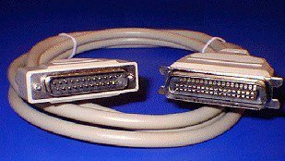
Typical Printer Cable
DB25P (male)
Connects to PC
Centronics male
36 pins
Connects to printer

Slide 59
Pinouts
Direc-
tion
out
out
out
out
out
out
out
out
out
in
in
in
in
out
in
out
out
-
DB25 Pin
1
2
3
4
5
6
7
8
9
10
11
12
13
14
15
16
17
18-25
Cent. Pin
1
2
3
4
5
6
7
8
9
10
11
12
13
14
32
31
36
19-30,
33,17,16
Signal
/Strobe
Data0
Data1
Data2
Data3
Data4
Data5
Data6
Data7
/Ack
Busy
PaperEnd
SelectIn
/AutoFd
/Error
/Init
/Select
Ground
Function
low pulse (>0.5 µs) to send
LSB
.
.
.
.
.
.
MSB
Low pulse ack. (~5 µs)
High for busy/offline/error
High for out of paper
High for printer selected
Low to autofeed one line
Low for Error
Low pulse (>50 s) to init
Low to select printer
-

Slide 60
A Detailed Look
Let’s look at a few of the preceding examples in more detail
ISA
PCI
AGP
Serial
Parallel
SCSI
Ethernet

Slide 61
SCSI (1 of 2)
Small Computer Systems Interface
pronounced “scuzzy”
History
Developed by Shugart Associates (1981)
Originally called Shugart Associates Systems Interface (SASI, pronounced “sassi”)
Scaled down version of IBM’s System 360 Selector Channel
Became an ANSI standard in 1986
Used for…
Disk drives, CD-ROM drives, tape drives, scanners, printers, etc.

Slide 62
SCSI (2 of 2)
Configuration
Parallel, daisy chain
Requires terminator at end of chain
Versions (data width, data rate)
SCSI-1, Narrow SCSI (8 bits, 5 MBps)
SCSI-2 (8, bits 10 MBps)
SCSI-3 (8, bits, 20 MBps)
UltraWide SCSI (16 bits, 40 MBps)
Ultra2 SCSI (8 bits 40 MBps)
Wide Ultra2 SCSI (16 bits, 80 MBps)

Slide 63
SCSI Block Diagram
System bus
or
I/O bus
SCSI port
SCSI bus controller
I/O device
I/O device
I/O device
SCSI bus
Terminator

Slide 64
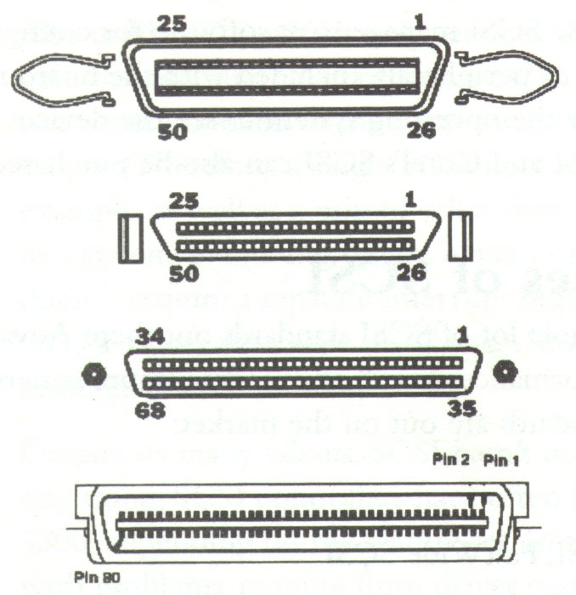
SCSI Connectors
Narrow SCSI
50 pins
Fast SCSI
50 pins
Fast Wide SCSI
68 pins
Ultra SCSI
80 pins

Slide 65
Putting it all together
LPT port
COM1 port
COM2 port
SCSI port
Parallel interface
Serial interface
SCSI
interface
ISA or PCI bus interface
CPU/system bus
ISA or PCI bus

Slide 66
A Detailed Look
Let’s look at a few of the preceding examples in more detail
ISA
PCI
AGP
Serial
Parallel
SCSI
Ethernet

Slide 67
Ethernet Interfaces
History
In 1980, Xerox, Digital Equipment Corporation (DEC, now Compaq), and Intel published a specification for an “Ethernet” LAN (local area network)
Now exists as a standard - IEEE 802.3
Physical interface uses either coax cable with BNC connectors or twisted pair cable with RJ-45 connectors (10Base-T)
Fast Ethernet
Specified in IEEE 802.3u (100Base-TX)

Slide 68
Ethernet Interfaces
Data Rate
10 Mbits/s for Ethernet (10Base-T)
100 Mbits/s for Fast Ethernet (100Base-TX)
Configuration
Serial, multi-point (token ring or token bus)

Slide 69
Token Bus

Slide 70
Token Ring

Slide 71
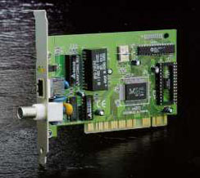
Ethernet Adapter Example - PCI
Addtron
AEF-360TX
RJ-45 connector
BNC connector
PCI bus interface

Slide 72
RJ-45 Pinouts
Pin Signal Direction Function
1 TD+ → Transmit data
TD- ← Transmit data return
RD+ ← Receive data
- - -
- - -
RD- → Receive data return
- - -
- - -
1
8

Slide 73
3. Device Controllers
The device controller is the hardware that controls the communication between the system and the peripheral drive unit.
They take care of the low level operations such as error checking, moving disk heads, data transfer, and location of data on the device.
There are many types of device controllers in a computer system.

Slide 74
Device Controllers -2
In truth, any device connected to the computer is connected by a plug and socket, and the socket is connected to a device controller.
These device controllers use binary and digital codes and typically have a local buffer, command registers, and more.
Communications – in the transfer of data and the ‘handshaking’ that must take place between device controllers and the CPU is very interesting and very diverse.

Slide 75
Device Controllers - 3
Controllers operate ports, buses, or devices.
A serial controller is simple and controls signals on wires of a serial port
A SCSI bus controller can be very complex because the SCSI protocol itself is complex and may well control many physical devices connected in quite diverse ways.
SCSI bus controller is often implemented as a separate circuit board (or a host adaptor) that plugs into the computer.
The SCSI circuit board may well contain an extra processor, microcode, and some private memory to enable it to process the SCSI protocol messages.
Microcode and a processor doing may handle bad-sector mapping, pre-fetching, buffering, and caching.

Slide 76
Setting Up I/O – CPU Communications with Device Controllers
Controllers have registers for data and control signals.
Processors communicate with controller by reading and writing bit patterns in these registers
One way to communicate with controller is by reading and writing bit patterns in these registers and enabling control bits and status bites for communications..
Communications can occur by accessing using these registers sometimes with standard assembler like instructions and other times (ahead) via special instructions.
Instructions typically specify the transfer of a byte or word.
Instructions trigger bus lines to select the proper device and to move bits into and out of device registers.

Slide 77
Thank you

